Slide 1
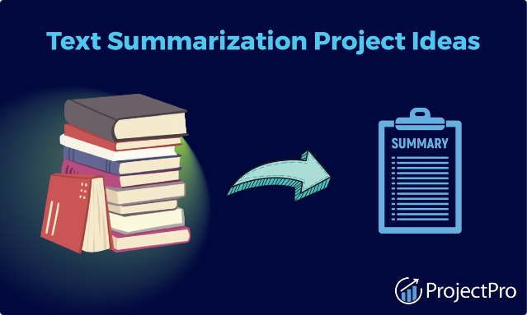

Text Summarization: Distilling the Essence

Slide 2
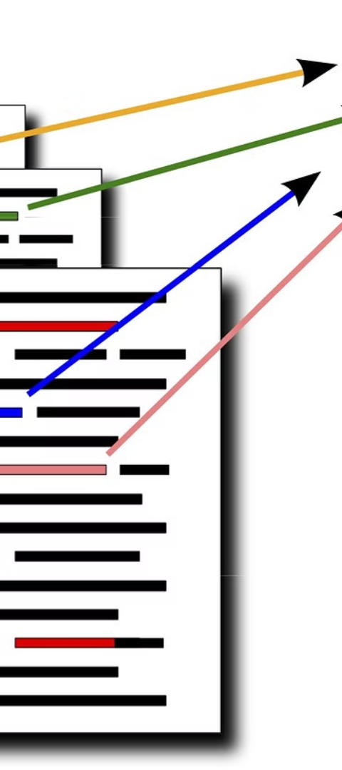
What is Text Summarization?
1
Condensing Information
2
Preserving Meaning
The goal is to capture the core ideas and maintain the overall meaning of the original text in a shortened form.
Text summarization is the process of extracting the key points and essential information from a longer text, creating a concise summary.
3
Improving Efficiency
Summarization helps readers quickly grasp the main points, making information more accessible and saving time.

Slide 3
The Importance of Text Summarization
Information Overload
Decision Making
Knowledge Retention
In the digital age, we are bombarded with vast amounts of text. Summarization helps us navigate and process this information efficiently.
Summaries provide a concise overview, allowing decision-makers to quickly identify key insights and make informed choices.
Summaries aid in retaining and understanding the most salient points, making the information more memorable.

Slide 4

Extractive vs. Abstractive Summarization
1
Extractive
Selects and extracts the most important sentences or phrases from the original text to form the summary.
2
Abstractive
Generates new text that captures the key ideas, using advanced language processing to rephrase and combine information.

Slide 5
Software Requirements
Jupyter Notebook: For developing and testing the summarization models
NLTK (Natural Language Toolkit): For tokenization, stop words, etc.
Transformers: For pretrained models like BERT, T5, and Pegasus.
scikit-learn: For LSA, TF-IDF, and other traditional machine learning method
NumPy: Numerical operations
Matplotlib: Data visualization
rouge_score: Evaluation metrics for summarization
Torch: Deep learning framework

Slide 6
Identifying Gaps and Challenges
Coherence and Context: Many existing systems struggle with producing coherent and contextually accurate summaries.
Scalability: Handling large datasets efficiently remains a significant challenge.
Evaluation Metrics: There is a need for more comprehensive metrics that capture human judgment effectively.

Slide 7
Techniques for Text Summarization
Frequency Analysis
Semantic Analysis
Identifying the most frequently occurring words and phrases to determine the most important content.
Understanding the meaning and relationships between concepts to extract the most relevant information.
TF-IDF (Term Frequency-Inverse Document Frequency)
LSA (Latent Semantic Analysis)
Machine Learning
Graph-based Methods
Leveraging advanced algorithms to learn patterns and generate summaries based on training data.
Modeling the text as a graph and using network analysis to identify the most central and influential components.
BERT (Bidirectional Encoder Representations from Transformers)
TextRank
T5 (Text-To-Text Transfer Transformer)
Pegasus

Slide 8
System Design
Data Collection/Preprocessing
Preprocessing: Tokenization, stop word removal, text cleaning.
Feature Extraction
Sentence Embeddings: Using BERT or similar models for embeddings.
Summarization Methods
Traditional Methods: TF-IDF, TextRank, LSA.
Machine Learning Models: BERT, T5, Pegasus.
Postprocessing
Sentence Selection: For extractive summarization.
Text Generation: For abstractive summarization.
Evaluation
Metrics: ROUGE score calculation.

Slide 9
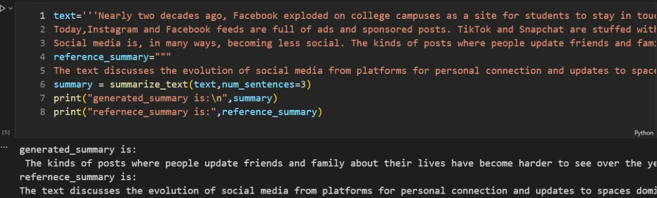
Implementation
Text Rank:
Text Rank is a graph-based ranking algorithm for text summarization. Similar to PageRank, it identifies the most important sentences in a document by ranking them based on their connectivity in a graph.
Step 1: Sentence Tokenization- Splitting the text into individual sentences.
Step 2: Sentence Similarity Calculation- Calculating the similarity between sentences to create edges in the graph.
Step 3: Graph Construction- Building a graph where sentences are nodes and edges represent similarity scores.
Step 4: Sentence Ranking- Applying the PageRank algorithm to rank sentences based on their importance.
Step 5: Summary Generation- Selecting top-ranked sentences to form the summary.

Slide 10
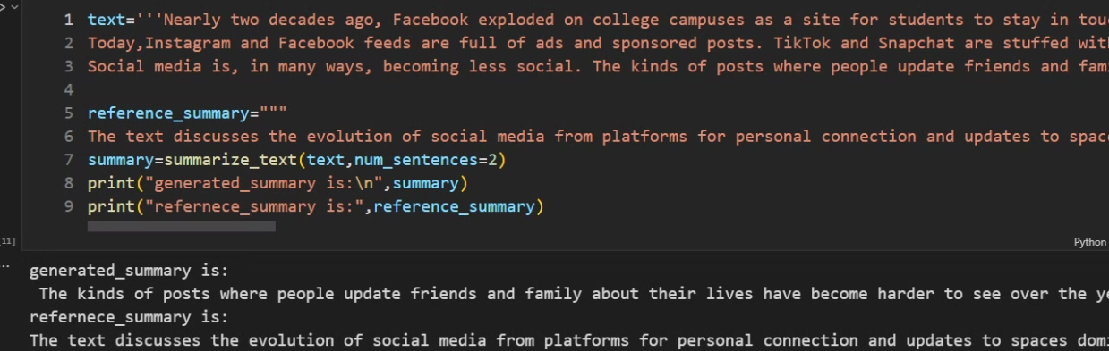
TF-IDF (Term Frequency-Inverse Document Frequency):
TF-IDF is a numerical statistic that reflects the importance of a word in a document relative to a corpus. It helps in identifying the most significant words in a document for text summarization.
Step 1: Tokenization- Splitting the text into individual words or terms.
Step 2: Term Frequency Calculation: Calculating the frequency of each term in the document.
Step 3: Inverse Document Frequency Calculation: Calculating the inverse document frequency for each term.
Step 4: TF-IDF Score Calculation: Multiplying term frequency with inverse document frequency to get TF-IDF scores.
Step 5: Summary Generation: Selecting sentences with the highest TF-IDF scores.

Slide 11
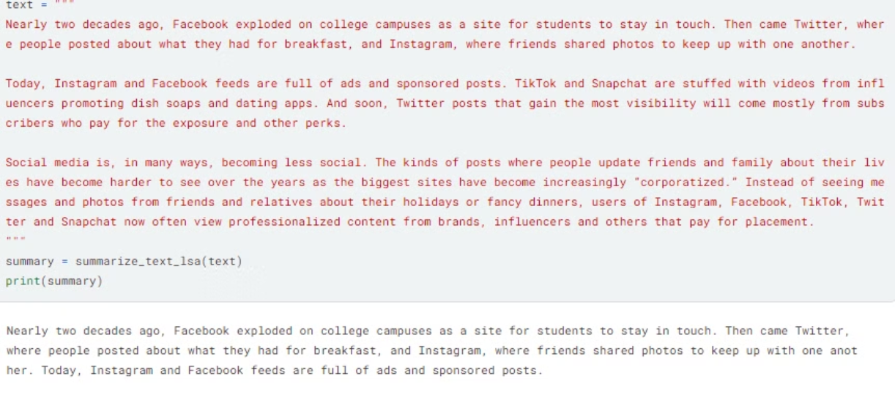
Latent Semantic Analysis (LSA):
It is a technique in natural language processing that analyzes relationships between a set of documents and the terms they contain by producing a set of concepts related to the documents and terms.
Step 1: Term Frequency Matrix- Creating a term frequency matrix.
Step 2: Singular Value Decomposition (SVD)- Applying SVD to reduce the dimensionality of the term-document matrix.
Step 3: Concept Identification- Identifying key concepts in the text.
Step 4: Sentence Scoring- Scoring sentences based on their relevance to the identified concepts.
Step 5: Summary Generation- Selecting top-scoring sentences to form the summary.

Slide 12
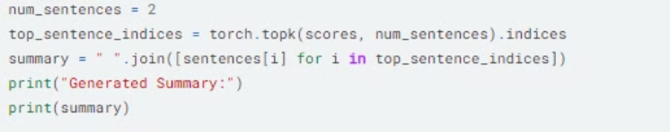
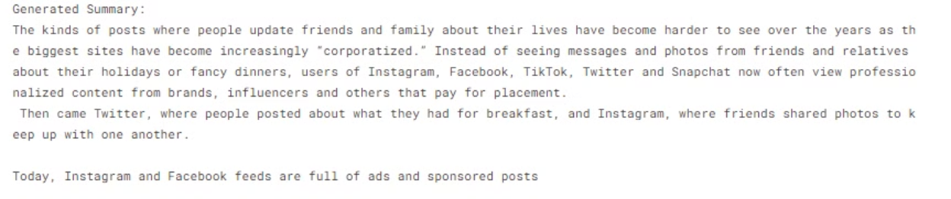
BERT (Bidirectional Encoder Representations from Transformers):
It is a transformer-based model pre-trained on a large corpus of text and fine-tuned for various NLP tasks, including summarization.
Step 1: Pre-trained Model Loading- Loading a pre-trained BERT model.
Step 2: Text Preprocessing- Tokenizing and encoding the text.
Step 3: Model Inference- Using the model to generate embeddings and identify key sentences.
Step 4: Sentence Ranking- Ranking sentences based on their embeddings.
Step 5: Summary Generation- Selecting top-ranked sentences to form the summary.

Slide 13
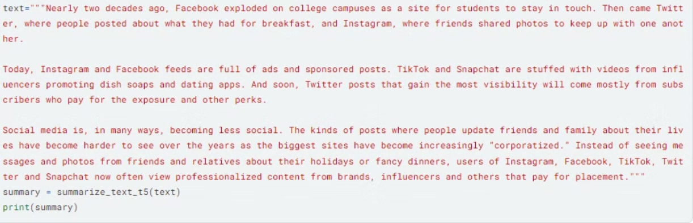
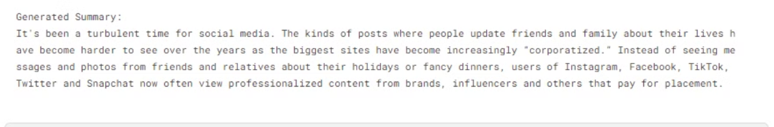
T5 (Text-To-Text Transfer Transformer) & Pegasus Model:
T5- It is a powerful machine learning model developed by Google AI for various text-based tasks. It's a type of encoder-decoder transformer architecture that has been pre-trained on a massive dataset of text and code.T5 can be used for both extractive and abstractive text summarization, but it depends on the fine-tuning approach.
Pegasus- It is a state-of-the-art deep learning model specifically designed for generating abstractive text summaries.
Step 1: Pre-trained Model Loading- Loading a pre-trained BERT model.
Step 2: Text Preprocessing- Tokenizing and encoding the text.
Step 3: Model Inference- Using the model(base, small, large) to generate embeddings and identify key sentences.
Post-processing (Optional)- You may perform additional processing on the generated summary to refine it (e.g., grammatical checks, sentence length adjustments, redundancy removal)
Step 5: Summary Generation- Selecting top-ranked sentences to form the summary.
Pegasus summary

Slide 14

Summarization with T5 model

Slide 15
Summarization with Pegasus model

Slide 16




Applications of Text Summarization
News Summarization
Academic Summarization
Email Summarization
Medical Summarization
Concise summaries of current events and breaking news.
Condensing research papers and scholarly articles.
Generating quick overviews of long email threads.
Summarizing patient records and clinical notes.

Slide 17
Evaluating Text Summarization
ROUGE
Measures the overlap between the summary and reference texts, assessing content quality.
BLEU
Evaluates the grammatical correctness and fluency of the generated summary.
Pyramid
Assesses the informative content of the summary, focusing on important concepts.
Human Evaluation
Subjective assessments by human raters on aspects like relevance, coherence, and usefulness.

Slide 18
Testing
Introduction
The purpose of the testing phase is to evaluate the performance of various text summarization models on a standardized dataset. The models tested include TF-IDF, TextRank, LSA, T5, Pegasus, and a BERT-based model.
Evaluation Metrics
The performance of the models was evaluated using the following metrics:
ROUGE-1: Measures the overlap of unigrams between the generated and reference summaries.
ROUGE-2: Measures the overlap of bigrams between the generated and reference summaries.
ROUGE-L: Measures the longest common subsequence between the generated and reference summaries.

Slide 19
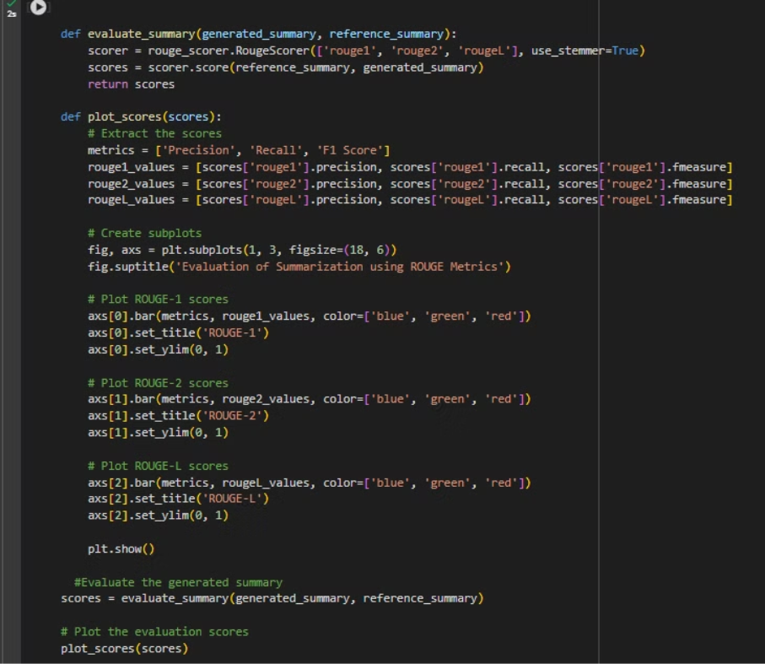

Slide 21
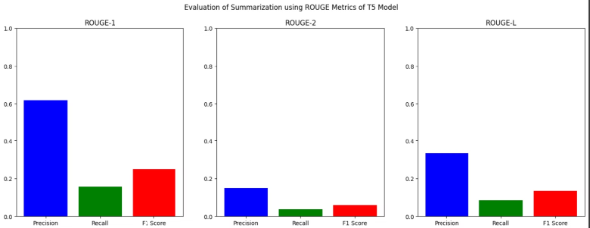
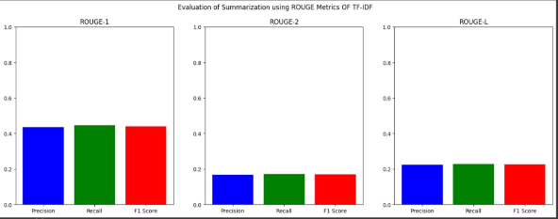
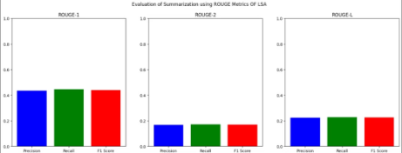
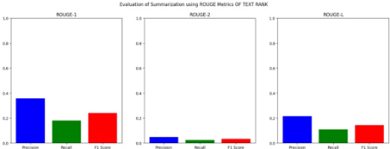
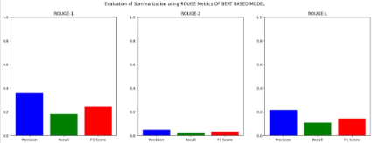
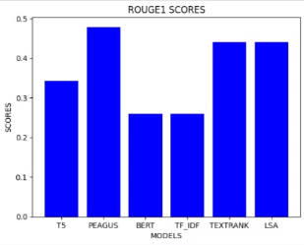
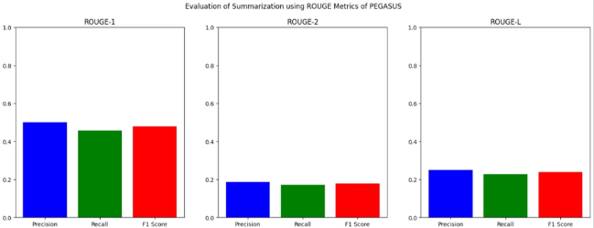
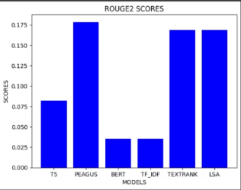
Evaluation Charts

Slide 22
Future Enhancement
Hybrid Approach: Combine strengths of extractive (TextRank/TF-IDF) and abstractive (T5/Pegasus) methods for a more comprehensive summary.
Hierarchical Summarization: Generate summaries at different levels of detail to cater to various needs.
Domain-Specific Tuning: Fine-tune models on domain-specific data (e.g., medical text, legal documents) for improved accuracy.
Multilingual Summarization: Extend the system to handle text summarization in multiple languages.
Summarization with Sentiment Analysis: Include sentiment analysis to capture the emotional tone of the summarized text.

Slide 23
Conclusion
Our exploration of various text summarization techniques (TextRank, TF-IDF, LSA, T5, Pegasus) revealed valuable insights:
Extractive vs. Abstractive: Extractive methods (TextRank, TF-IDF) are efficient for identifying key sentences but lack the ability to rephrase information. Abstractive methods (T5, Pegasus) offer higher fidelity summaries but require more computational resources.
Accuracy and Resources: Pre-trained models like T5 and Pegasus often achieve higher accuracy but come at a cost of greater computational power.
Task Specificity: The ideal summarization method depends on the specific task. TextRank or TF-IDF might suffice for short summaries highlighting key points, while T5 or Pegasus could be preferred for comprehensive and informative summaries.
Ultimately, the choice of text summarization method depends on the specific needs of the application, balancing factors like desired level of abstractiveness, accuracy requirements, and available computational resources. Our project has laid a strong foundation for further exploration and development of a robust and versatile text summarization system.

Slide 24
References
Business System Bharati Vidyapeeth Deemed University College of Engineering, Pune, Text Summarizer Using NLP (Natural Language Processing) (JUL 2022)
Dr Sumathi Pawara* , Dr Manjula Gururaj Hb , Dr Niranajan N Chiplunarc bAssociate Professor,Nitte(Deemed to be University),NMAMIT, Karkala, Karnataka, India ,cProfessor, Nitte (Deemed to be University),NMAMIT, Karkala, Karnataka, India, Text Summarization Using Document and Sentence Clustering Method (2022)
Narendra Andhale Department of Computer Engineering Vishwakarma Institute of Information Technology Pune, India and L.A. Bewoor Department of Computer Engineering Vishwakarma Institute of Information Technology Pune, India .An Overview of Text Summarization Techniques

